Slide 1

Metropolitan counties working together to prevent insect transmitted disease and annoyance since 1958
Category L - Part 1 - Mosquito Biology & Species

Slide 2
Mosquito Biology and Identification
Part 1: Outline
MMCD Overview
Mosquito Biology
Mosquito Species and Disease Vectors
Mosquito Habitat

Slide 3
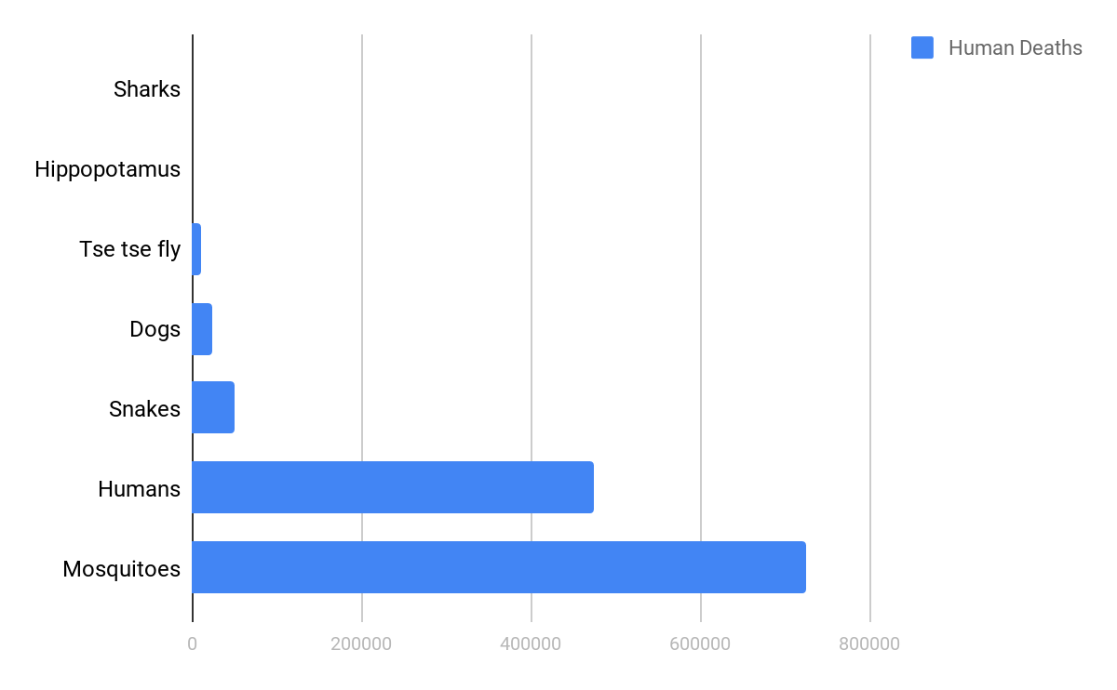
Mosquitoes – Our Biggest Enemy

Slide 4
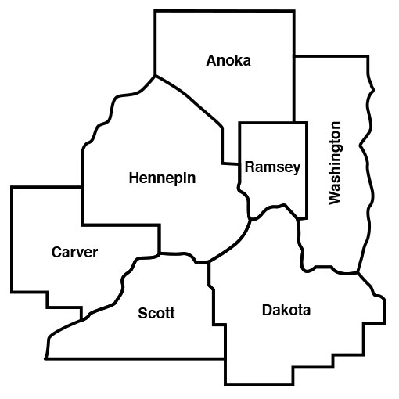
MMCD Governance
Established in state statutes in 1958
Governed by a board of 18 elected County Commissioners
2,900 square mile service area
Population 3,010,000
70,000 wetland habitats
30,000 woodland habitats

Slide 5
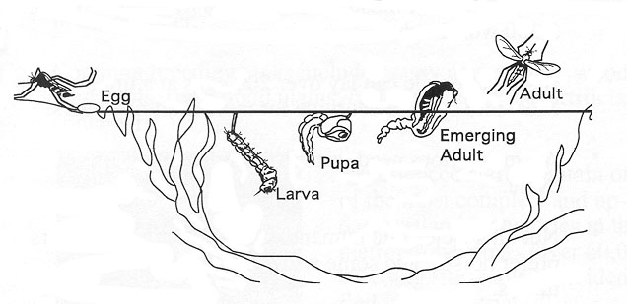
Mosquito Biology
Eggs laid individually on moist soil (Aedes species)
Eggs laid in a raft on the waters surface (Culex species)

Slide 6
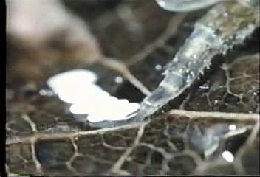
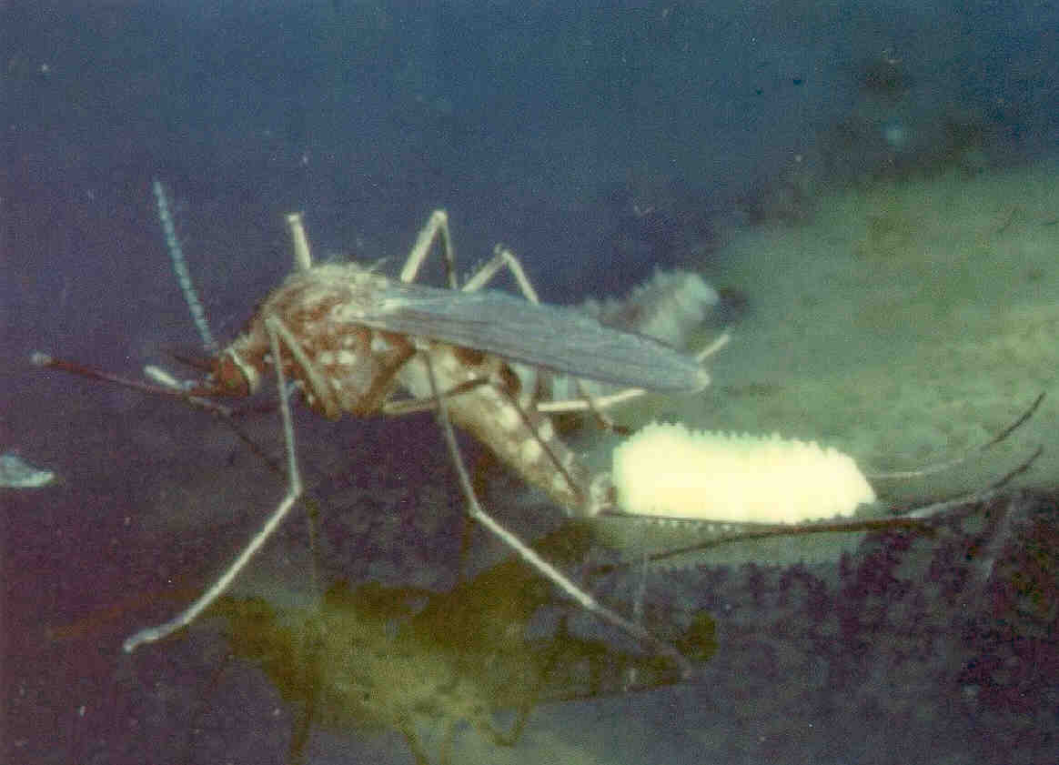
Egg Laying

Slide 7
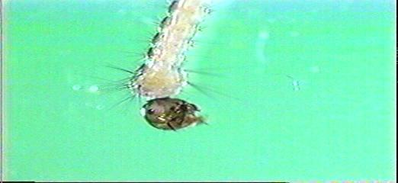
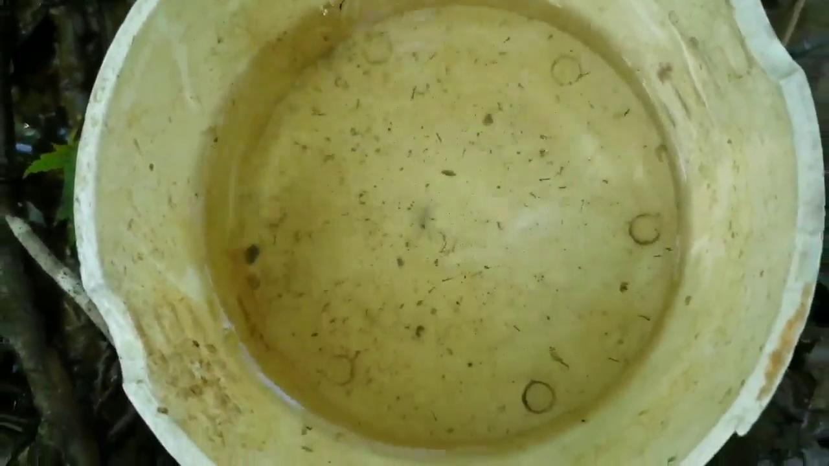
Larvae
4 growth stages
called “instars”
Larval stage lasts 4-14 days.

Slide 8
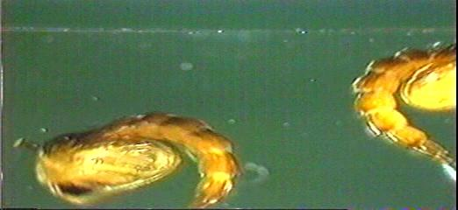
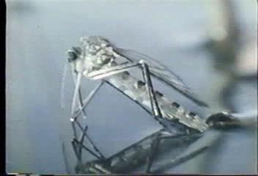
Pupae

Slide 9
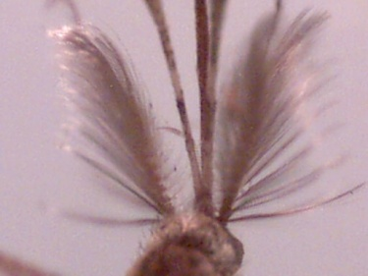
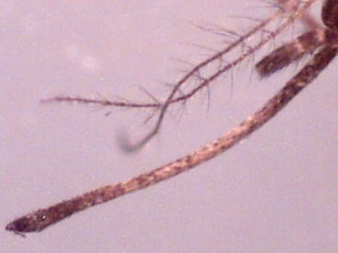
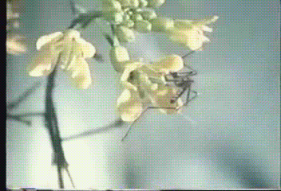
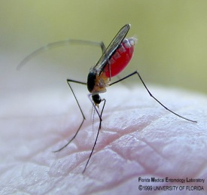
Adult Mosquitoes
MALE
FEMALE
Anatomy:
Food Source:
General Life Expectancy:
Up to
3 months
10-20 days
Notes:
The biggest distinction between the male and female mosquito is the antennae. The male mosquito has a large, bushy antennae for locating the buzz of a potential mate. The response is species-specific, so that a male Culex pipiens, for example, will only respond to a female of his kind and not one of the other 13 species. The wing shape and beat pattern of the female mosquito create a courtship song that is species-specific for her mate. Typically, a mosquito flaps its wings about 600 times per second.
The female mosquito is the most infamous of the two sexes because of her craving for fresh blood, which she needs for extra protein in egg production. The female has mouthpart which are suitable for piercing the skin while the males do not.
While life expectancy varies with the species, in general, the mosquitoes in Minnesota live from about 10 days up to about 3 months. The male mosquito generally has a shorter life expectancy. Unlike many other insects, the mosquito does not necessarily die after biting or laying her eggs. The female's life span ranges from as little as 3 days up to 100 days.

Slide 10
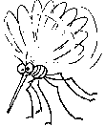
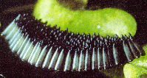
Mosquito Math
1st
Generation:
+
Blood
meal
=
(150 females)
2nd
Generation:
150 females + mom = 151 egg rafts x 300 =
45,300 mosquitoes (22,650 females)
3rd
Generation:
22,650 females X 300 eggs =
6,795,000 mosquitoes (3,397,500 females)
3,397,500 females X 300 eggs = 1,319,250,000 mosquitoes
All in less than one month, from one female mosquito!
* Eggs can survive unhatched for up to 7 years!

Slide 11
Mosquito
Species and Variety

Slide 12
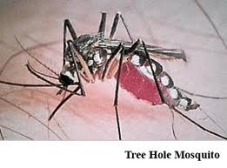
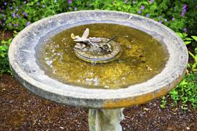
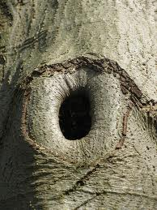
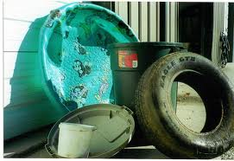
Aedes triseriatus
“Tree hole mosquito” or “Old silver sides”
Container breeder
Vector of La Crosse encephalitis
Present mid-June through September

Slide 13
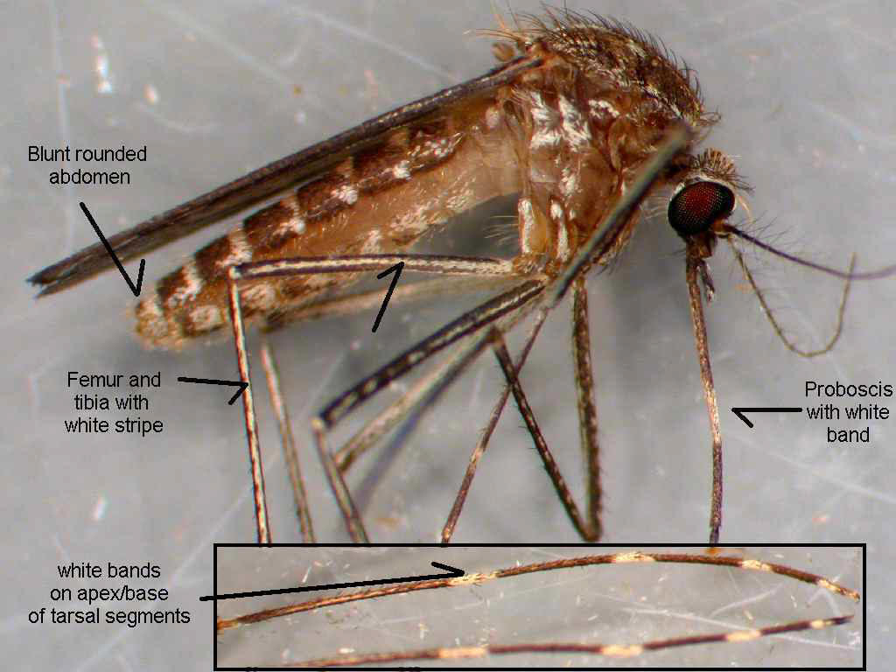
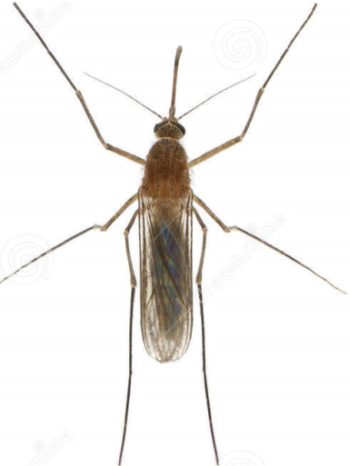
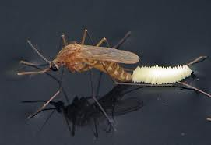
Culex species
Most common: Culex tarsalis, Culex pipiens, Culex restuans
Lay eggs on standing water (egg rafts)
Most common mid-June through September.
WNV or WEE vector

Slide 14
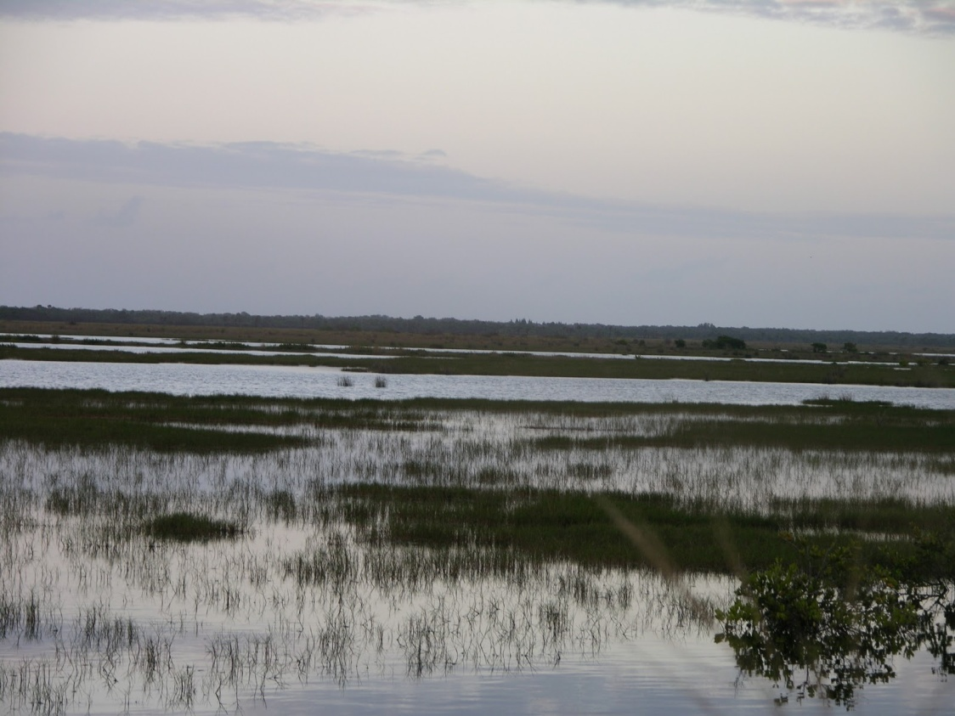
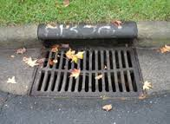
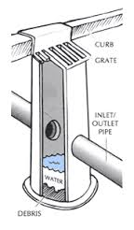
Culex habitat
Cx. tarsalis - duck marshes (prairie potholes region)
Cx. pipiens – catch basins or containers

Slide 15
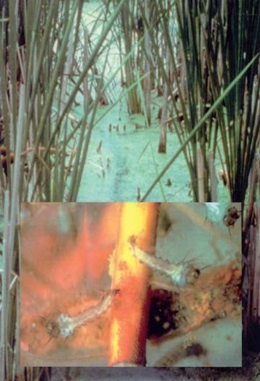
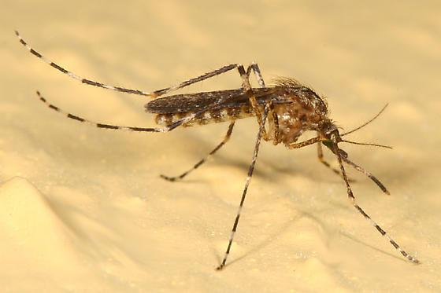
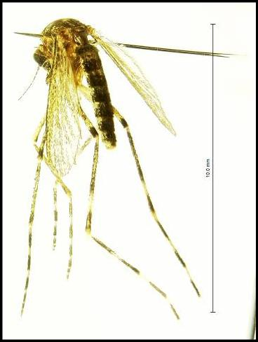
Coquillettidia perturbans
“Cattail mosquito”
One brood per year (July 4th)
Larva attach to water roots and breathe through plants
Bridge vector of EEE

Slide 16
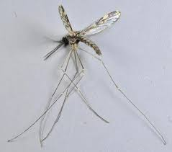
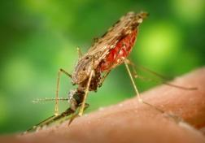
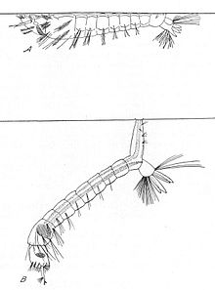
Anopheles species
Lay single eggs on water surface
Larvae have no siphon and are parallel with surface of water.
Heavily scaled wings
Angled biter
Vectors of many diseases around the globe

Slide 17
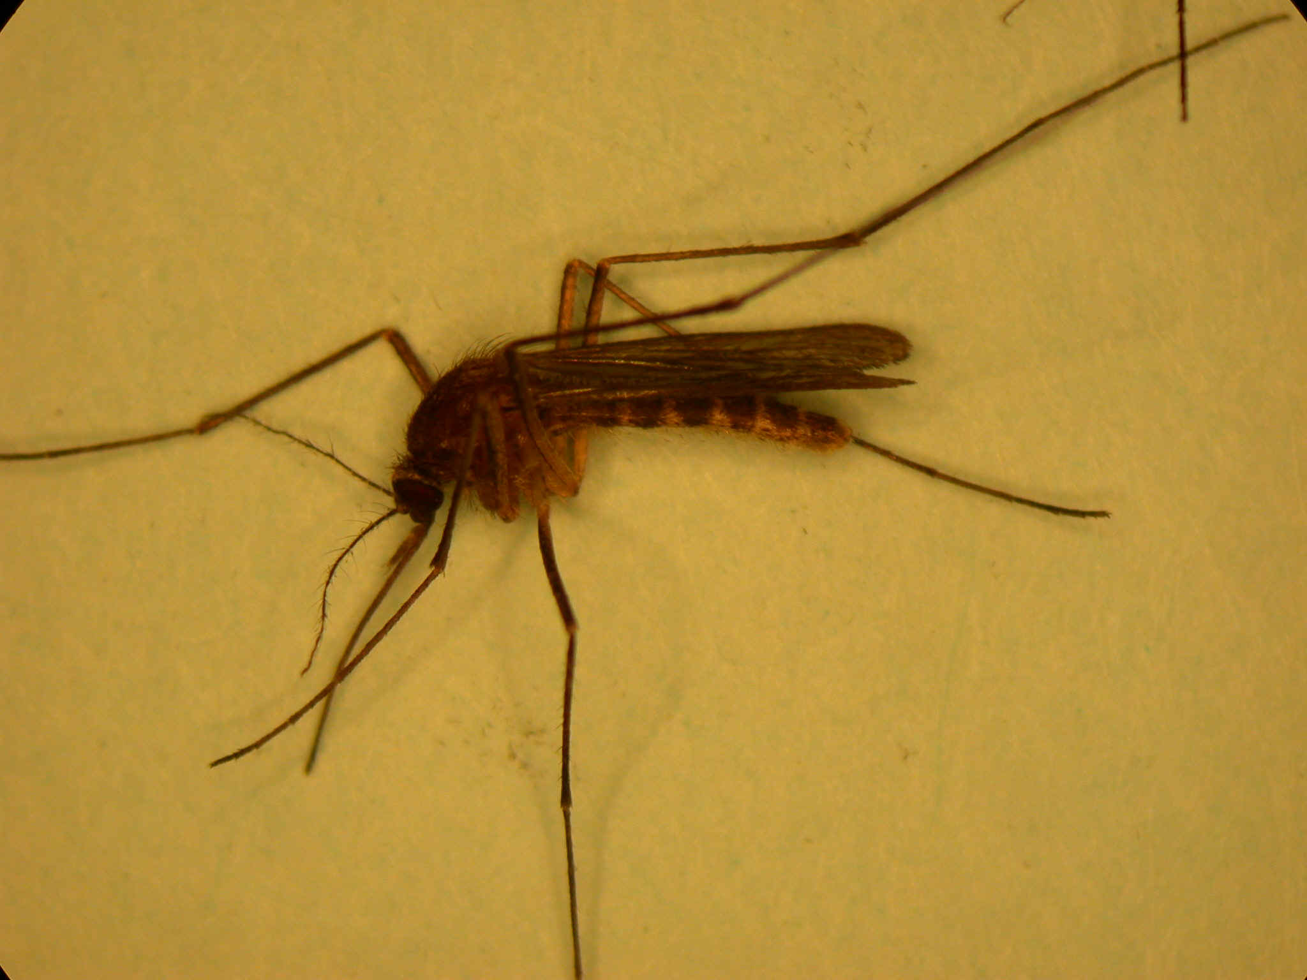
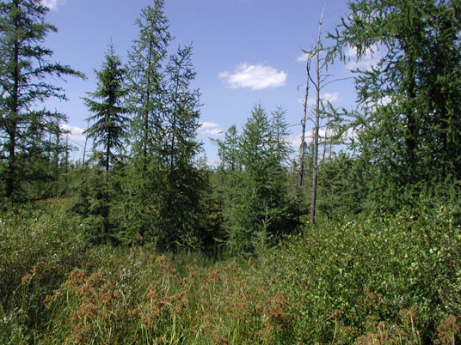
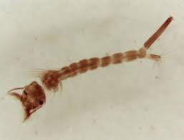
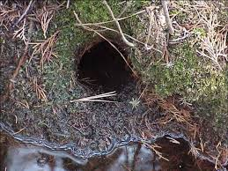
Culiseta species
Culiseta melanura
Tamarack bog habitat
Reclusive - Difficult to treat (crypts and recessed areas)
Low population numbers
EEE vector

Slide 18
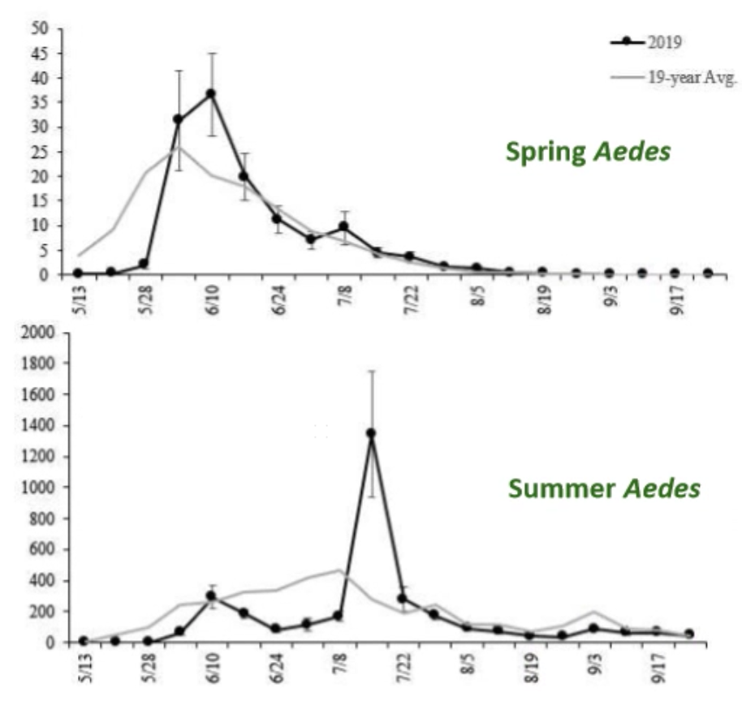
Spring Aedes
Aedes abserratus, Aedes punctor, Aedes stimulans, Aedes excrucians
Snowmelt mosquitoes. Bogs and woodland pools
Vector of Jamestown Canyon virus

Slide 19
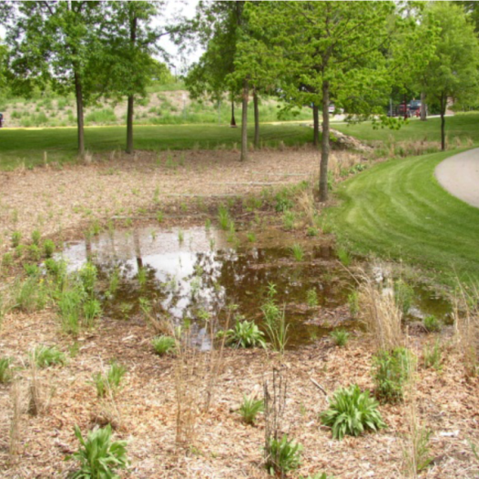
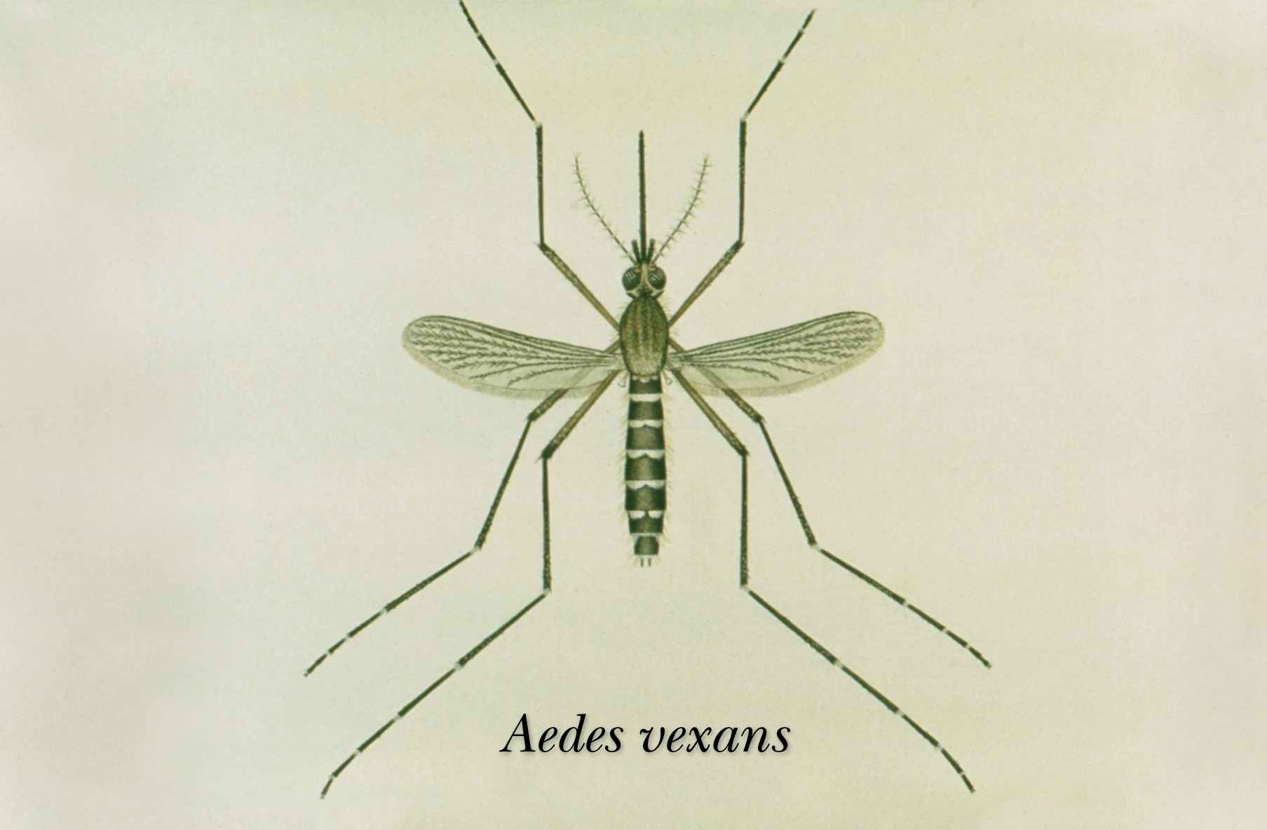
Aedes vexans
Summer Aedes, “floodwater mosquito”
Lay eggs on edges of rain pools, flooded woodlands, and wetlands
Can fly further than 20 miles from hatch site.
Vector of dog heartworm.

Slide 20
Mosquito Habitat
and Behavior

Slide 21
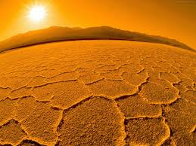
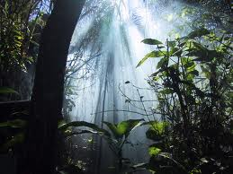
What do adult mosquitoes need to survive?
Warm temperatures
Humidity
Protection from the sun
Sugar source for energy
Blood meal to nourish eggs

Slide 22
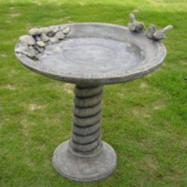
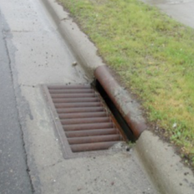
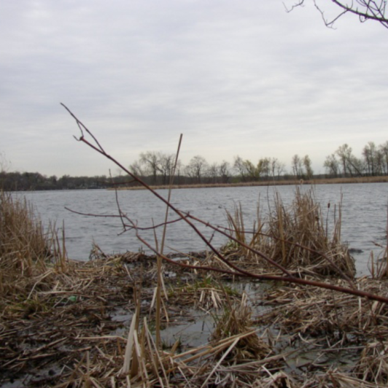
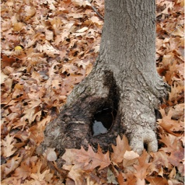
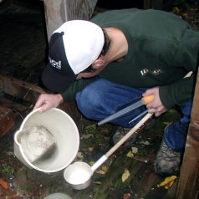
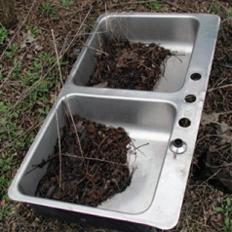
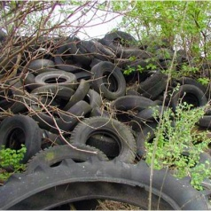
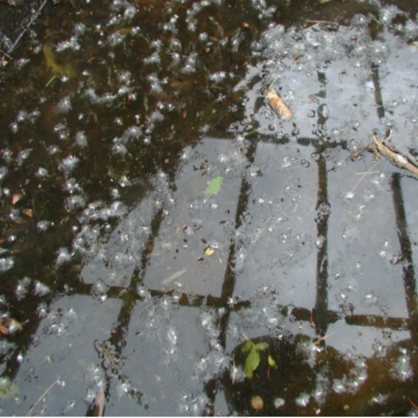
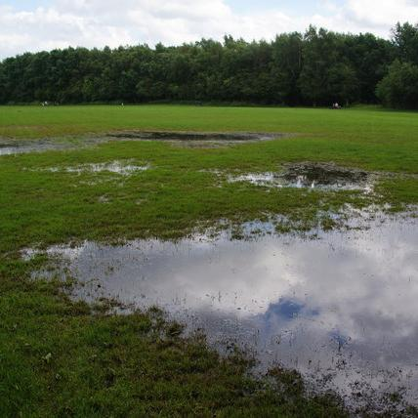
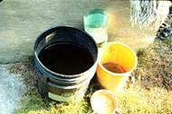
Larval Habitat
Containers
Permanent Water
Flood Water

Slide 23




Good Harborage Areas

Slide 24

When are mosquitoes active?
Most mosquitoes have two prime activity periods
Some species have different patterns

Slide 25


What does a mosquito do at dusk?
At dusk, the humidity rises and temperature drops
Mosquitoes come out of their harborage spots and work their way to the wooded edge
Wait for sensory cues to determine where to go

Slide 26

What are the sensory cues?
Visual (movement, color, shape, etc.)
Scents (body odors, carbon dioxide, perfumes, etc.)
Temperature (warm bodies, heat sources, etc.)
Light (artificial lights, fires, etc.)
Attractant & Disruption research is ongoing

